Slide 1


Amazon Sales Data
Analysis
Presented By : Minakshi Dhote

Slide 2

ANALYSING AMAZON SALES
Project Title | Analyzing Amazon Sales Data
Technology | Data Science
Domain | E-Commerce
Project Difficulty level | Advanced

Slide 3

Problem Statement:
Sales management has gained importance to meet increasing competition and the need for improved methods of distribution to reduce cost and to increase profits.
Sales management today is the most important function in a commercial and business enterprise.

Slide 4

Business Solution :
Do ETL: Extract-Transform-Load some Amazon dataset and find for me
Find Sales-trend -> month-wise, year-wise, yearly_month-wise
Find key metrics and factors and show the meaningful relationships between attributes.

Slide 5
Data Description:
Dataset : https://drive.google.com/file/d/10sofXyF6NjwN6ngLyFfiPI-CUDpeqaN_/view

Slide 6
Technology Used :
Python for data processing
Python libraries like Pandas, Numpy, Matplotlib and Seaborn for data visualisation

Slide 7
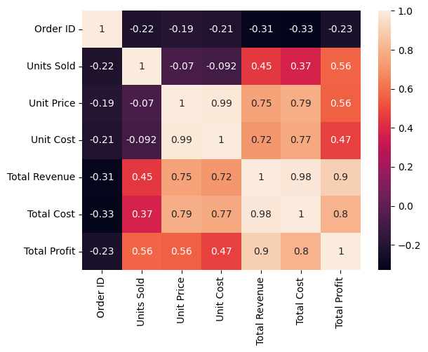
Sales Features :
As you can see in the above heatmap Unit Price and Unit Cost are Highly correlated.
Also Unit Price moderately related to Total Revenue and Total Cost but less related to Total Profit.

Slide 8
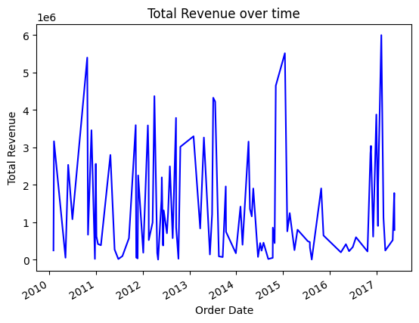
Total Revenue overtime

Slide 9
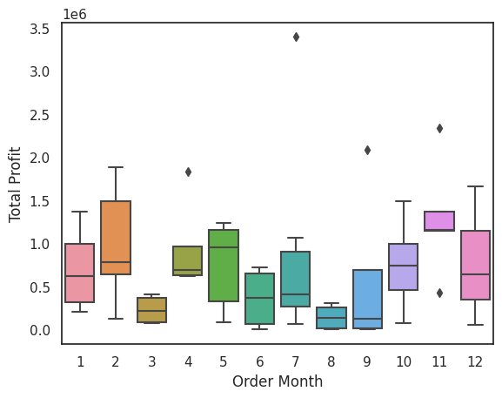
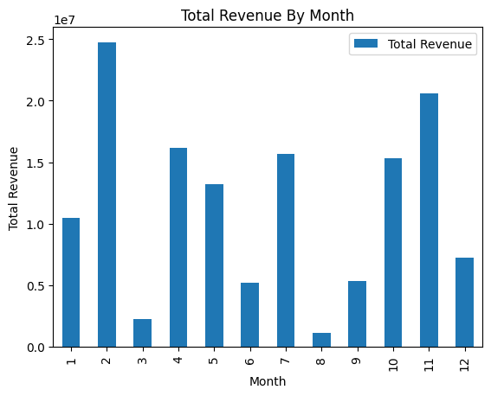
Monthly Revenue and Profit

Slide 10
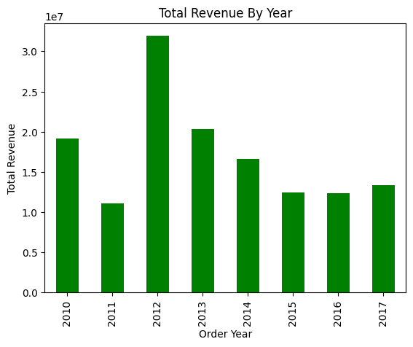
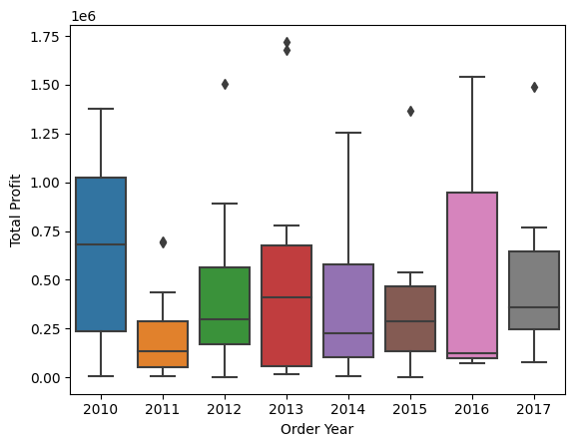
Yearly Revenue and Profit

Slide 11
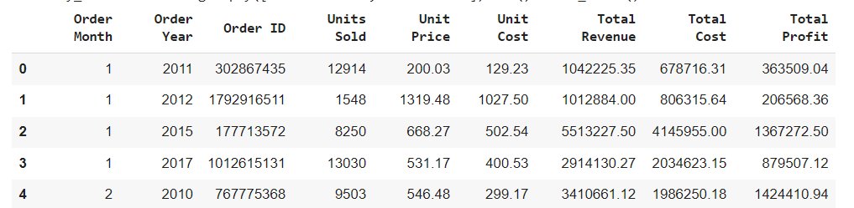
Yearly Month wise sales

Slide 12
Link for Python Notebook :
https://colab.research.google.com/drive/13xe0chUkH2M9UYSGyVeLQP0ktTQJpY6K

